Slide 1


RSSD: Defend against Ransomware with Hardware-Isolated Network-Storage Codesign and Post-Attack Analysis
Benjamin Reidys
Peng Liu* Jian Huang
*
Notes:
Hello everyone, I am Benjamin Reidys, a PhD Student at UIUC. I am presenting our work, RSSD, which leverages hardware isolated network-storage codesign to create a fundamental solution to encryption ransomware attacks by enabling zero data loss recovery and trusted post-attack analysis. This work was done in collaboration with...

Slide 2

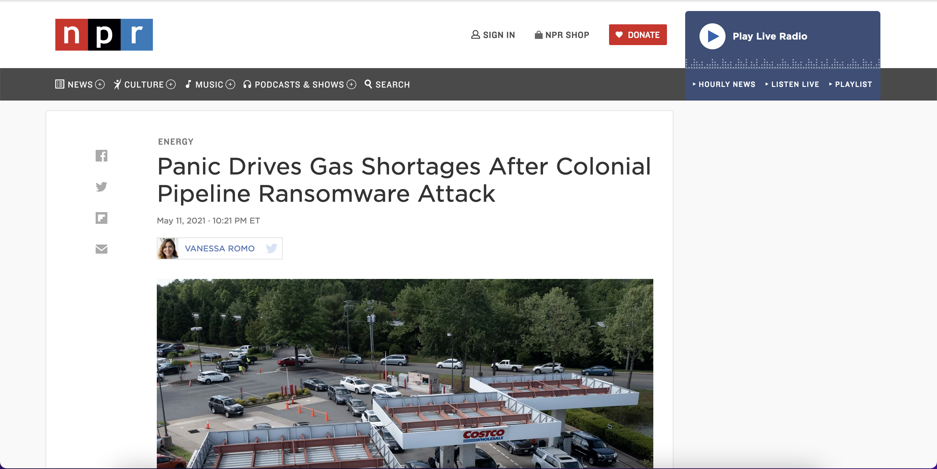
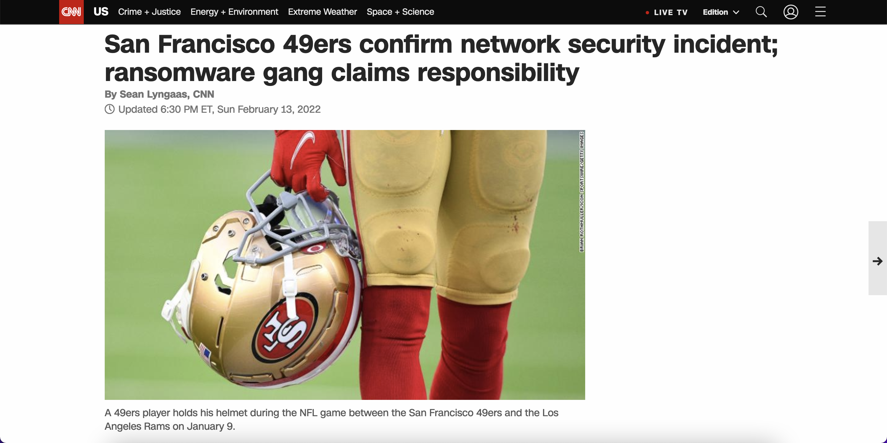
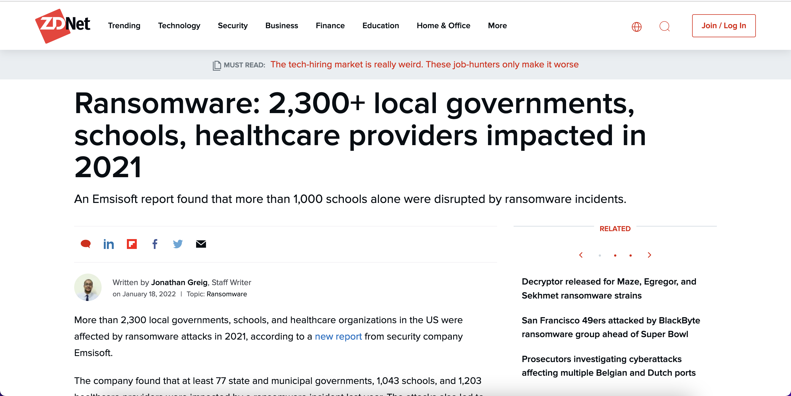
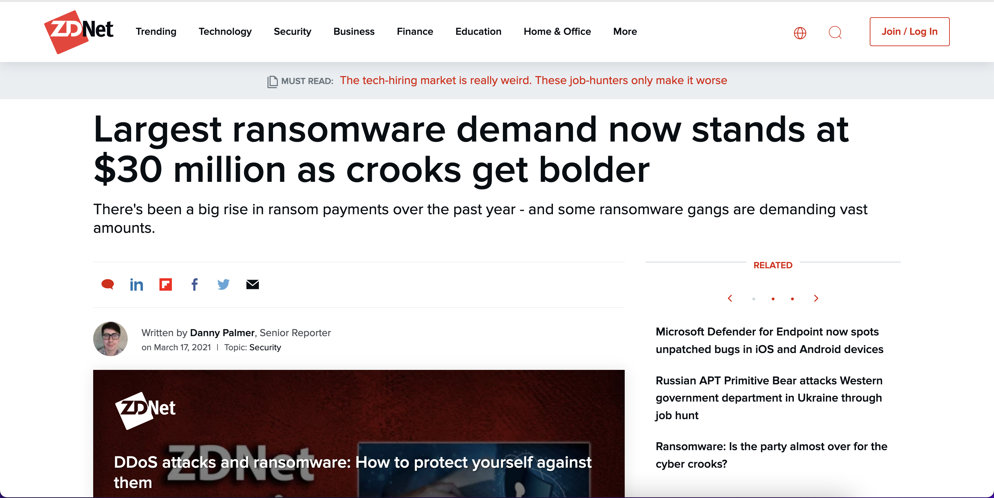
Ransomware Attacks are a Major Threat
Systems Platform Research Group at UIUC
Notes:
“Ransomware attacks are a major threat”
Skip headlines if short on time

Slide 3



What is Encryption Ransomware?
Destroy
original files
Demand ransom to decrypt data
Encrypt files
Systems Platform Research Group at UIUC
Notes:
So, what is encryption ransomware. Typically, attackers start by deploying malware to gain access to the victims system.

Slide 4


State-of-the-Art Defenses: Software-Based Approaches
Malware Detection
Data Backups
Cannot recover files encrypted before detection!
Backups could be targeted by ransomware!
Systems Platform Research Group at UIUC
Notes:
To defend against ransomware..
“Ransomware can obtain OS kernel privileges and terminate or destroy these data backups”

Slide 5
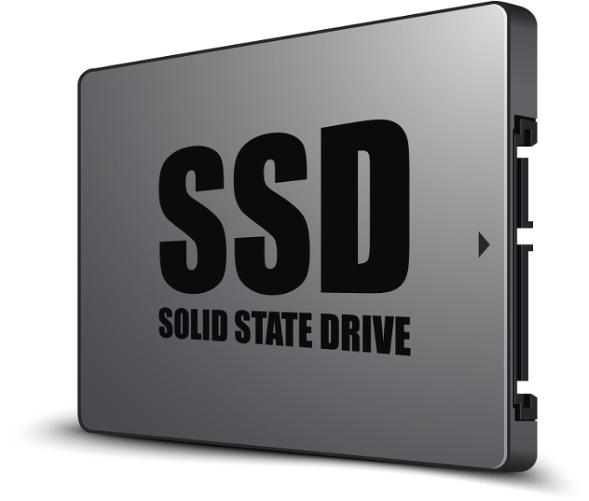
State-of-the-Art Defenses: Hardware-Based Solutions
FlashGuard (CCS ‘17)
SSD-Insider (ICDCS’18)
TimeSSD (EuroSys’19)
Exploit out-of-place updates in SSD to retain victim data!
Systems Platform Research Group at UIUC
Notes:
Due to the shortcomings of software based approaches...
Researchers realized that we can exploit the out-of-place updates intrinsic to SSDs.
Read previous work list

Slide 6
SSD 101
Free Page
Valid Page
Invalid Page
Z
Old version is invalidated!
Old version is retained!
X
X’
Flash has out-of-place updates!
Flash Block
Past storage states can be retained for recovery!
Systems Platform Research Group at UIUC
Notes:
To facilitate discussion of hardware-based solutions I will discuss some basic information about flash storage

Slide 7



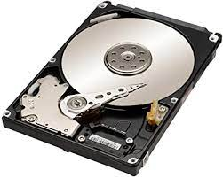
Ransomware will Evolve
SSDs are becoming increasingly popular
Block I/O Device
Adapting to SSDs requires few changes
Systems Platform Research Group at UIUC
Notes:
Currently, ransomware does not differentiate between the underlying block I/O devices
SSDs are becoming increasingly popular so they will become increasingly targeted by ransomware and bypass existing hardware-based solutions. We also observe that adapting attacks to SSDs requires few changes.

Slide 8



Ransomware Evolution: Ransomware 2.0
GC Attack
Timing Attack
Trim Attack
Waits until data is removed by default GC!
Dump large amounts of data to SSD to trigger GC!
Use trim command to directly remove data!
Systems Platform Research Group at UIUC
Notes:
To demonstrate ransomwares adaptation to SSDs, we identify three new attacks circumventing SSD based protections that we call Ransomware 2.0.
Gc attack leverages the insight that GC can remove data permanently from the SSD. Therefore, we dump large data
hide attack pattern

Slide 9

Ransomware 2.0: GC Attack
Free Block
Valid Block
Retained Invalid Block
SSD
X
X’
Encrypt victim data
GC removes victim data
Start
Dump garbage data
End
Systems Platform Research Group at UIUC
Notes:
I will now go over each attack in detail...

Slide 10

Ransomware will Evolve: Timing Attack
Ransomware 2.0: Timing Attack
Free Block
Valid Block
Retained Invalid Block
SSD
X
X’
A
B
C
D
Encrypt victim data
GC removes victim data
Start
Wait for user storage operations
End
Systems Platform Research Group at UIUC
Notes:
Emphasize hiding

Slide 11

Ransomware 2.0: Trim Attack
Free Block
Valid Block
Retained Invalid Block
SSD
X
X’
Encrypt victim data
GC removes victim data
Start
Trim victim data
End
Systems Platform Research Group at UIUC
Notes:
Include trim explanation

Slide 12




Ransomware 2.0 Requires a Fundamental Solution
Stronger Data Retention
Zero Data Loss Recovery
Trusted Post-Attack Analysis
Learn Evolving Patterns
Systems Platform Research Group at UIUC
Notes:
Ransomware 2.0 shows us that ransomware can and will evolve to circumvent defenses in new and unpredictable ways. We need a fundamental solution that can protect against future evolutions of ransomware. Ransomware 2.0 shows that hardware based solutions must still strengthen their data retention. Therefore, a fundamental solution will need to enable zero data loss recovery. If we can successfully recover all of the victims data without paying the ransom, then ransomware attacks will stop as they are no longer profitable. Secondly, we must be able to learn evolving ransomware patterns. To that end, a fundamental solution requires trusted post-attack analysis such that we can understand ransomware trends and adapt to them.

Slide 13
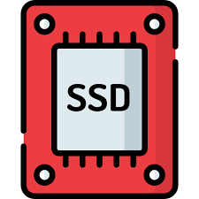



RSSD: Hardware-Isolated Network-Storage Codesign
Transparently offload retained data to remote servers!
Stronger Data Retention
Zero Data Loss Recovery
Network-Storage Codesign
Track all operations within the SSD in time order!
Learn Evolving Patterns
Trusted Post-Attack Analysis
Hardware-Assisted Logging
Systems Platform Research Group at UIUC
Notes:
To implement zero data loss recovery and trusted post-attack analysis we design a ransomware-aware SSD we call (RSSD). Since local storage capacity is limited, we leverage remote servers to store retained data. RSSD achieves this by integrating a hardware-isolated network component and uses NVMe-oE to transfer stale data to the remote servers. Second, RSSD achieves trusted post attack analysis via hardware-assisted logging by tracking all storage operations within the SSD in time order.

Slide 14
RSSD: Hardware-Isolated Network-Storage Codesign
RSSD
Network-Storage Codesign
Hardware-Assisted Logging
Systems Platform Research Group at UIUC
Notes:
We combine these features into a single SSD by modifying the architecture and firmware.

Slide 15
Threat Model for Encryption Ransomware
Application
userspace
kernel
Block Driver
Block I/O Interface
RSSD
Smaller Trusted Computing Base!
Hardware Isolated from Malicious Processes!
Systems Platform Research Group at UIUC
Notes:
Incorporating these features into a single SSD means we can strengthen the threat model. We do not need to trust the upper level system. Instead, we only trust the SSD firmware. This has two benefits. First, the SSD firmware has a smaller trusted computing base making it generally more secure. Second, the SSD firmware is hardware-isolated underneath the block interface from higher-level malicious processes. This is especially relevant for ransomware since attackers are often in the system long before they deploy the actual ransomware, giving them plenty of time to deploy other exploits.

Slide 16


RSSD: Design Challenges
Limited Local Storage Capacity
Impact on Storage Performance
Trusted
Post-Attack Analysis
Hardware-isolated logging
Transfer data during idle cycles
Compress retained data
Log operations in time order
Keep valid data locally
Hardware isolated data transfer
Systems Platform Research Group at UIUC
Notes:
However, developing RSSD is not easy, we have to overcome the following challenges. First is the limited local storage capacity in the SSD. We overcome this by using delta compression for stale data and network storage codesign to transparently offload stale data to a remote server. Maintaining stale data will inevitably incur overheads. Therefore our second challenge is how to guarantee good performance under these conditions. We do this by keeping all valid data locally for I/O operations and only transferring data during idle I/O cycles. Finally, we also must enable trusted post-attack analysis entirely within the SSD. To do so, first RSSD tracks all storage operations within the SSD firmware and tracks them in time order both within the SSD and in the remote server.

Slide 17
Hardware-Isolated Network-Storage Codesign
Block I/O Interface
Embedded Processor
On-Board DRAM
Interconnect Bus
DMA
Flash
Controllers
Control Register
Tx Buffer
Rx Buffer
MAC
Flash
Chip
Transceiver
Ethernet
Flash
Systems Platform Research Group at UIUC
Notes:
First, to let us discuss the limited local storage capacity. No matter how efficiently we use the local storage capacity, it will eventually fill with stale data. Therefore we leverage remote servers to expand the local storage capacity. In a traditional way, we would need to export data via the host networking, but we do not trust the upper level system. Therefore we integrate a hardware isolated network component into the SSD. To begin, in a secure environment, users can configure the connected IPs of the remote servers via the control register. Then, upon deployment this is disabled. RSSD also includes a DMA engine to transfer stale pages to the Transmission queu which are transferred to the remote server without being exposed to the host. This is feasible since it adds less than 5% area overhead and consumes minimal power and the existing SSD architecture already has the needed processor and DRAM.

Slide 18

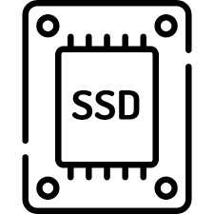
Performance Optimizations in RSSD
Idle!
I/O
I/O
Transfer only retained data
Use idle cycles to transfer data
Delta compression
Stale data is rarely accessed!
Transfer data during predicted idle cycles!
Reduce storage overhead and data transferred!
Systems Platform Research Group at UIUC
Notes:
Second, we consider the performance optimizations to avoid interference from the retained data. First, since page updates typically only update a few items and we naturally retain old versions, we enable delta compression to only store these difference. This reduces both the local storage overhead and reduce the amount of data transferred over the network. Second, since users rarely access the retained data, there is no need to keep it locally and for performance we export it aggressively to remote servers. The transfer of stale data helps free space for the SSD to use for local operations. Finally, there are often small gaps between user storage operations that we can leverage to transfer stale data without interfering with the storage operations. To predict the next idle time of the SSD, we use a simple exponential weighted moving average. If we mispredict, we suspend the transfer until the I/O request is completed to avoid interference.

Slide 19



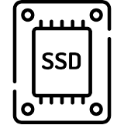

Enabling Trusted Post-Attack Analysis
Only 24% report post-attack analysis!
Analysis took 6 weeks on average!
Software-based logging cannot be trusted!
Hardware-Assisted Logging
Write
Read
Trim
Trusted post-attack analysis is highly desirable!
Systems Platform Research Group at UIUC
Notes:
Finally, we must enable trusted post-attack analysis. Post-attack analysis seeks to by track the history of operations that led up to an attack and use it to learn ransomware patterns. This is critical for victims and law enforcement to understand evolving ransomware trends. To understand the state of the art, we analyzed major recent ransomware attacks and found that only 24% reported conducting post-attack analysis and this analysis lasted an average of nearly 6 weeks. Even worse, these solutions operate at an OS level which cannot be trusted. Therefore we enable hardware-assisted logging to log all storage operations inside the SSD firmware in time order. We establish the trust via hardware-isolation.

Slide 20
Tracking Invalid Data in Time Order
Enabling Trusted Post-Attack Analysis
Enabling Trusted Post-Attack Analysis
0
Each bloom filter represents one epoch!
0
0
0
1
1
1
0
1
1
0
PPA
0
...
...
...
...
GC checks bloom filters before transferring!
0
0
0
0
1
1
1
0
0
0
0
0
Bloom filters reset in time order
Inactive Bloom Filter
Active Bloom Filter
Inactive Bloom Filter
Active Bloom Filter
RSSD
Hardware-Assisted Logging
Write
Read
Trim
Systems Platform Research Group at UIUC
Notes:
Let us now go over how we track each operation. For writes, we implicitly track these via the invalid pages in time order with a set of bloom filters. Each bloom filter represents an epoch and one is considered active at each time. An invalid page is inserted into the active bloom filter. When GC tries to transfer the page, it checks the bloom filters and does not transfer the page if one of them is a hit. When a bloom filter is filled, the current active one becomes inactive and we replace the oldest inactive one with a new one. This effectively releases the pages from that epoch to be transferred.

Slide 21
Tracking Reads in Time Order
Enabling Trusted Post-Attack Analysis
LPA
Timestamp
Read Buffer
RSSD
Hardware-Assisted Logging
Write
Read
Trim
Systems Platform Research Group at UIUC
Notes:
We do not track reads in the same manner since they do not produce invalid pages. Instead we maintain a read buffer in the SSD DRAM which is periodically flushed to the flash when it fills up.

Slide 22
Tracking Trims in Time Order
Enabling Trusted Post-Attack Analysis
Trim
Address
Remapping
Trim
Flash Block
Flash Block
Flash Block
RSSD
Hardware-Assisted Logging
Write
Read
Trim
Systems Platform Research Group at UIUC
Notes:
We also track trim commands in a buffer like reads but we must do one more thing to secure the trim command. Remember that modern SSDs can issue the trim command to directly erase targeted blocks. Attackers will use this to erase retained data. To secure it, we give the system the illusion that the trim command is successfully executed by remapping the block to a free flash block. Instead, the data is retained and treated as pages invalidated by writes.

Slide 23
Putting It All Together
User Applications
File System
Block Driver
Retained Invalid Pages
Block I/O
Network
RSSD
SSD Firmware
Remote Cloud
NAND Flash
Read Operations
Trimmed Data
Systems Platform Research Group at UIUC
Notes:
To summarize, locally we keep retained invalid pages, read operations, and trimmed data. In the background the network utilizes idle cycles to transfer these to the remote cloud in time order.

Slide 24



Defending Against Ransomware 2.0
Defend against GC and timing attacks
Defend against trim attack
Defend against unknown future attacks
Retain trimmed data by repurposing the trimming function!
Retained data is used to recover!
Zero data loss recovery and trusted post-attack analysis!
Systems Platform Research Group at UIUC
Notes:
To see how we use RSSD to defend against Ransomware 2.0, we review the attacks we proposed. First the GC and timing attacks. For both attacks, since we transparently retain all stale data, the original versions can be found either in the SSD or on the remote server and used for recovery. For the trim command, by changing the functionality of the trim command we retain victim data while giving the system the appearance that it succeeds. Finally, since we enable zero data loss recovery and trusted post-attack analysis, we successfully defend against future attacks as well.

Slide 25
Programmable SSD
RSSD Implementation
1 TB
64 pages/block
4 KB/page
over-provisioning ratio: 15%
Ransomware Samples
1,477 ransomware samples (VirusTotal)
Experimental Setup
Storage Workloads
Enterprise servers (11 workloads)
University machines (6 workloads)
Storage benchmarks: IOZone/Postmark
Database workloads (TPCC/TPCE)
Notes:
We implement RSSD on an OpenSSD Cosmos+ FPGA Board. To evaluate, we use traces from real ransomware samples acquired from VirusTotal. We evaluate RSSD with storage traces from MSR, FIU as well as OLTP, IOZone, and PostMark to mimic real world workloads.

Slide 26
Impact on Data Retention Time
RSSD can retain data for over 200 days!
Systems Platform Research Group at UIUC
Notes:
To test the retention time we fill the SSD to 50% and start running various real world traces to mimic storage operations. LocalSSD represents an SSD that retains the stale versions of data locally. LocalSSD+Compression comporesses stale data versions.
LocalSSD can retain data for 1-11 days before filling up and rejecting writes. By compressing data, LocalSSD+Compression is up to 6.4x more effective. RSSD can retain data for over 200 days by transferring data to the remote cloud.

Slide 27
Impact on Storage Performance
RSSD introduces less than 1% performance overhead!
Systems Platform Research Group at UIUC
Notes:
We next evaluate the impact of RSSD on the latency of I/O operations. We fill the SSD to 80% and run the corresponding traces.
Regular SSD represents an unmodified SSD.
Our evaluation shows that naively storing the data results in 1.9x overhead since the smaller number of available free blocks results in more intensive GC operations. Comparing RSSD against LocalSSD+Compression results in less than 1% performance overhead from transferring stale data over the network.

Slide 28

Zero Data Loss Recovery
Network-Storage Codesign
RSSD Summary
Trusted Post-Attack
Analysis
Hardware-Assisted Logging
Notes:
In summary, We present three new attacks to represent evolutions in ransomware and identify zero data loss recovery and trusted post-attack analysis as critical to preventing these evolutions. We build RSSD to implement these with network-storage codesign and hardware-assisted logging.

Slide 29

Thank You!
Benjamin Reidys, Peng Liu, Jian Huang
breidys2@illinois.edu, pxl20@psu.edu, jianh@illinois.edu

Slide 30
Enabling Trusted Post-Attack Analysis
0
Each bloom filter represents one epoch!
0
0
0
LPA
Timestamp
1
1
1
0
1
1
0
PPA
0
...
...
...
...
GC checks bloom filters before transferring!
0
0
0
0
1
1
1
0
0
0
0
Write
0
Read
Trim
Bloom filters reset in time order
Inactive Bloom Filter
Active Bloom Filter
Inactive Bloom Filter
Read Buffer
Active Bloom Filter
Trim Buffer
RSSD
Write
Read
Trim
Systems Platform Research Group at UIUC
Notes:
What are the key points we want to highlight.
Current Post-Attack Analysis cannot be trusted since it operates at the OS level,
We add trust (and some challenges) by ensuring it is hardware isolated
Writes -> use bloom filters for each epoch in time order
Each BF represents an epoch.
GC checks the BF whether to export and a page
Pages are implicitly removed when the BF is replaced.
Read/Trim uses a separate buffer

Slide 31
Retain Compressed Invalid Pages in Time Order
Free Page
Valid Page
Set of bloom filters
Each bloom filter represents one epoch!
Invalid Page
Replace oldest bloom filter to start a new epoch!
0
0
0
Z
1
1
0
PPA
X
1
1
0
X’
...
...
...
0
0
0
1
1
0
Flash Block
0
0
0
Bloom Filter
Inactive Bloom Filter
Active Bloom Filter
Systems Platform Research Group at UIUC
Notes:
This is too complicated, we don’t actually need to show this much.

Slide 32
Enabling Delta Compression in RSSD
Page X’
Page X
Page X
Delta
=
Compressed Delta
with CR of ~0.2
Reference Flash Page
Retained Invalid Flash Page
Systems Platform Research Group at UIUC
Notes:
Cut

Slide 33
RSSD Can Improve Throughput
LocalSSD is 24.8% slower than Regular SSD!
RSSD outperforms LocalSSD by 1.31x!
Systems Platform Research Group at UIUC
Notes:
speedup-new.pdf
see whether you have time for latency and throughput.

Slide 34

Hardware-Isolated Network-Storage Codesign in RSSD
Embedded Processor
Page X
On-Board DRAM
High storage and network overhead!
Interconnect Bus
Delta compression!
DMA
Delta
Page
Flash
Controllers
Avoid data leakage!
Control Register
Tx Buffer
Rx Buffer
AES Encryption!
Avoid performance interference!
MAC
Flash
Chip
Transfer during idle cycles!
Transceiver
Ethernet
Flash
Systems Platform Research Group at UIUC
Notes:
Too many points in one slide. Split.
Connect the stuff on the right better with the picture on the left.
Cut after full arch…

Slide 35

Putting It All Together
Write
Trim
Read
Bloom Filters
Trim Buffer
Z
Read Buffer
PPA
X
Remap
X’
Delta Compression
Flash Block
Free Flash Block
Free Page
Valid Page
Invalid Page
Systems Platform Research Group at UIUC
Notes:
What are the key points we want to show.
The overall architecture:
SSD, the network component, remote server.
The point is to show the full history of a single page.
Highlight the steps -> bf -> delta compressed -> exported during idle cycles -> stored in the remote server in time order
Read and trim operations are tracked in a buffer when they are issued.

Slide 36

Zero Data Loss Recovery
Free Page
Valid Page
Invalid Page
File Recovered!
Flash Block
A
Target page is compressed
Reference page used for recovery
X
Target page is remote
Y
# Deltas
Offsets
LPA
PPA
TS
Ref
Delta
…
LPA
Timestamp
PPA
Target page is
uncompressed on SSD
Systems Platform Research Group at UIUC

Slide 37

Network-Storage Codesign
Application
kernel
Block Driver
Network
SSD
Block I/O Interface
SSD Firmware
Data Backup
NAND Flash
Systems Platform Research Group at UIUC
Notes:
Technical meat

Slide 38
Ransomware 2.0: GC Attack
Start
Encrypt victim
data
Write garbage
data
GC removes victim data
End
Systems Platform Research Group at UIUC
Notes:
Cut if short on time

Slide 39

Ransomware 2.0: Timing Attack
Start
Encrypt victim
data
Wait for user
storage operations
GC removes victim data
End
Systems Platform Research Group at UIUC
Notes:
Cut if short on time

Slide 40

Ransomware 2.0 : Trim Attack
Start
Encrypt victim
data
Trim victim data
GC removes victim data
End
Systems Platform Research Group at UIUC
Notes:
Cut if short on time

Slide 41
Managing Stale Data
Free Page
Valid Page
Invalid Page
Transfer to remote server
during idle cycles
Bloom Filters
Flash Block
A
Encryption
PPA
X
Delta Page
X’
# Deltas
Offsets
LPA
PPA
TS
Ref
Delta
…
Delta Compression
4
4
4
4
1
48
B
B
B
B
B
B
Data
OOB
LPA
Timestamp
PPA
4
4
4
B
B
B
Systems Platform Research Group at UIUC

Slide 42
Hardware-Assisted Logging
Free Page
Valid Page
Read Operation
Trim Operation
Invalid Page
Flash Block
Read Buffer
A
Can’t log Read/Trim in OOB!
X
LPA
Timestamp
4
4
Y
B
B
LPA
Timestamp
PPA
Trim Buffer
Store write timestamps in OOB
Systems Platform Research Group at UIUC

Slide 43
Putting it All Together
Write Operation
Read Operation
Trim Operation
Read Buffer
Trim Buffer
A
Bloom Filter and LPA Chain
X
A
Y
Flash Block
X
Free Page
Valid Page
Bloom Filter and LPA Chain
Invalid Page
Y
Trimmed Flash Block
Free Flash Block
Systems Platform Research Group at UIUC

Slide 44
Evaluation: Recovery
RSSD is 4.2x faster on average!
LocalSSD+Compression takes 12.4% more time!
Systems Platform Research Group at UIUC
Notes:
Recovery-new.pdf

Slide 45
Compressing Stale Data
Page X’
Page X
Page Z
Delta
Page Y
Delta
Page X
Delta
Delta Page
=
# Deltas
Offsets
LPA
PPA
TS
Ref
Delta
…
Delta for one page
Reference Flash Page
Retained Invalid Flash Page
Compressed Delta
with CR of ~0.2
Systems Platform Research Group at UIUC
Notes:
Network/Storage Codesign here.
Talk (in detail) the pipeline for data transfer and use the compression as a single box.

Slide 46
Network-Storage Codesign
Block I/O
Network
X
SSD Firmware
NAND Flash
Encryption
Remote Server
Transfer during idle cycles!
Systems Platform Research Group at UIUC
Notes:
Too high level. Need to offer specific details.
Here is the meat.

Slide 47
Tracking Data in Time Order
Free Page
Valid Page
Invalid Page
Read Operation
Bloom Filters
Trim Operation
Flash Block
Read Buffer
A
Can’t log Read/Trim in OOB!
PPA
X
LPA
Timestamp
X’
Data
OOB
Trim Buffer
LPA
Timestamp
PPA
Systems Platform Research Group at UIUC
Notes:
This one should go over the steps taken to ensure that each timestamp is taken in the OOB and the read and trim buffers
too busy.

Slide 48
Zero Data Loss Recovery
Free Page
Valid Page
Invalid Page
Trim Operation
File Recovered!
Flash Block
A
Target page is compressed
Reference page used for recovery
X
Target page is remote
X’
A
# Deltas
Offsets
LPA
PPA
TS
Ref
Delta
…
LPA
Timestamp
PPA
X
Bloom Filter and LPA Chain
Target page is
uncompressed on SSD
X’
Trimmed Flash Block
Free Flash Block
Systems Platform Research Group at UIUC

Slide 49
Trusted Post-Attack Analysis
Free Page
Valid Page
Read Buffer
Trim Buffer
Invalid Page
A
X
X’
…
Write X’
Read X
Read X
Trim B
Flash Block
Use timestamps to reconstruct!
Storage Operation Log
Systems Platform Research Group at UIUC
Notes:
remove

Slide 50
Tracking Reads in Time Order
Reads cannot be retained implicitly via retained pages!
Read Buffer
LPA
Timestamp
Minimized space overhead!
Systems Platform Research Group at UIUC
Notes:
Reads are a bit simpler, but are not tracked implicitly via retained pages.

Slide 51
Tracking Trim in Time Order
Trim
Trim Buffer
Z
X
LPA
Timestamp
Flash Block
Flash Block
Previous version of the block is retained for recovery!
Still must secure the trim command!
Free Page
Valid Page
Invalid Page
Systems Platform Research Group at UIUC
Notes:
What is trim/how is it used in ransomware?
How do we secure it?
Discuss the trim buffer in order to track the timestamps.

